Slide 1
Epilepsy/AFC data
Emily Johnson
5/24/19

Slide 2
PT in this slide deck Note: Image descriptions are in “Notes” section
PT36
PT7
PT5
PT3
PT34 – no post-op note indicating how the patient did
PT15
PT16
PT18 – cannot find post-op scan on ClinDesk, CT currently set at 111 (we need 333)
PT20 – cannot find post-op scan on ClinDesk, missing CT
PT26
PT28
PT32
PT33 – cannot find post-op scan on ClinDesk, CT is highly distorted
PT35

Slide 3
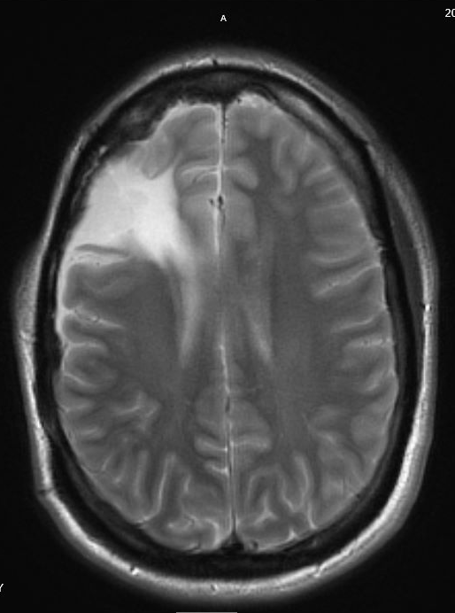
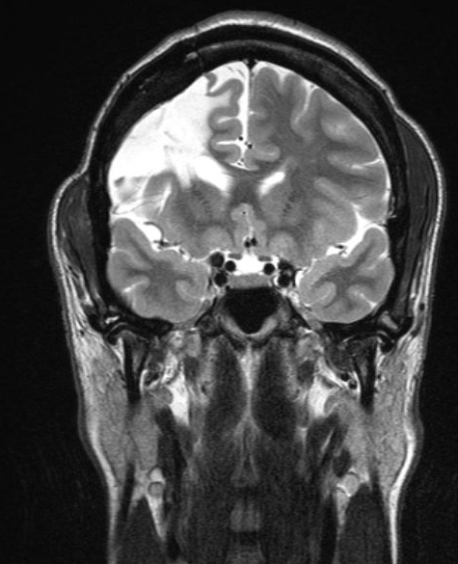
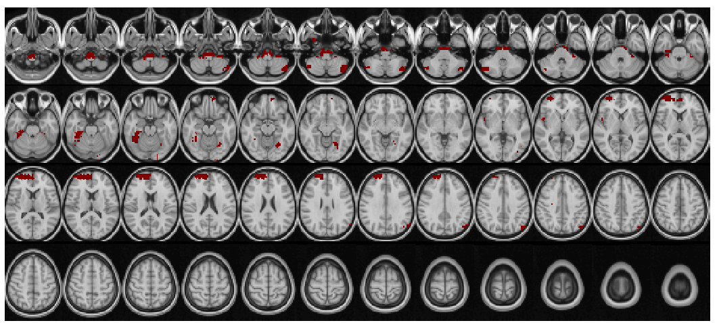
PT36
Patient Profile
Clinically determined R frontal lobe seizure onset
No abnormal findings noted on pre-op MRI
Seizure free at 1 year post-epilepsy resection.
R L
SD Threshold = 3
Notes:
Top left image = coronal post-op image showing R fronal lobe resection
Top right image = axial post-op image illustrating the region of resection in this patient
Bottom image = searchlight generated overlay of lesion regions

Slide 4
PT36 searchlight overlay with CT

Slide 5
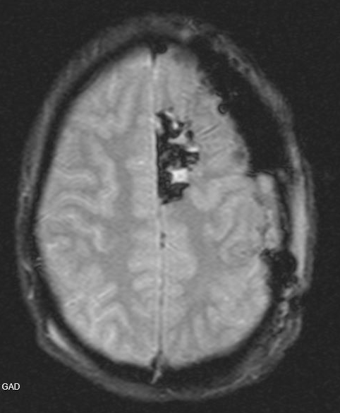
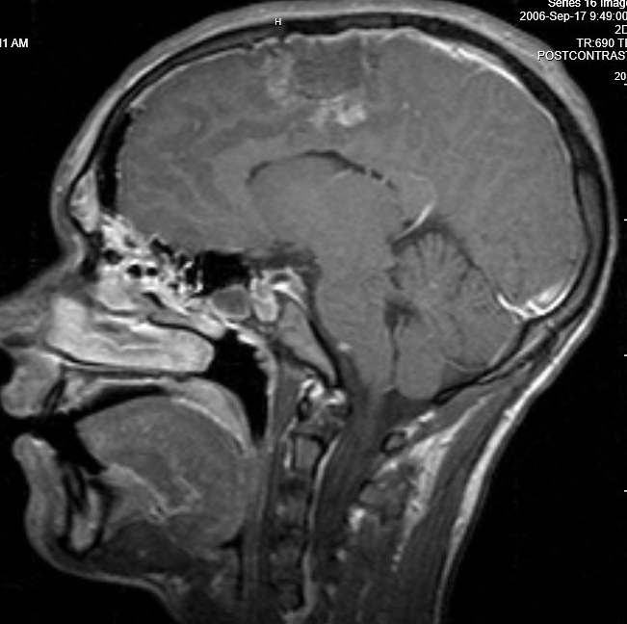
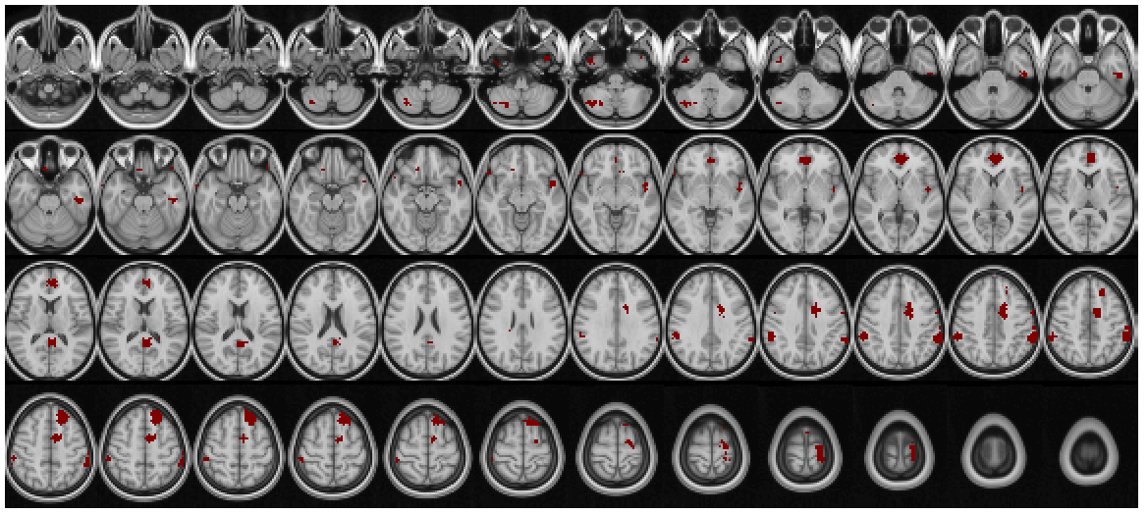
PT7
Patient Profile
Clinically determined L mesial frontal lobe onset (close to SMA)
No abnormal findings noted on pre-op MRI
Seizure free at 1 year post-epilepsy resection.
R L
SD Threshold = 3
Notes:
Top left image = sagittal post-op MRI showing L mesial resection
Top right image = axial post-op MRI showing L mesial resection
Bottom image = searchlight generated overlay of lesion regions

Slide 6
PT7 searchlight overlay with CT

Slide 7
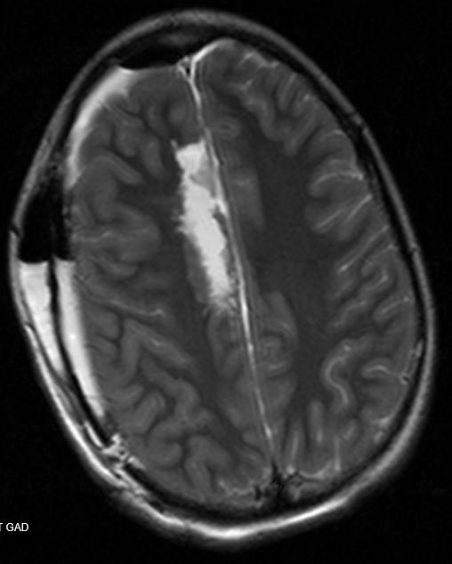
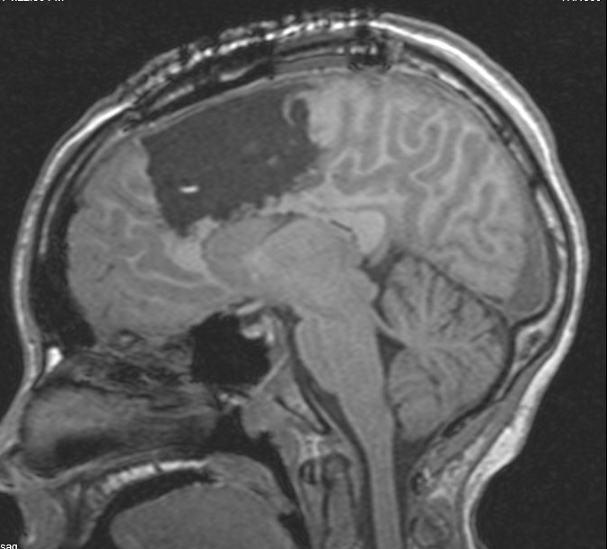
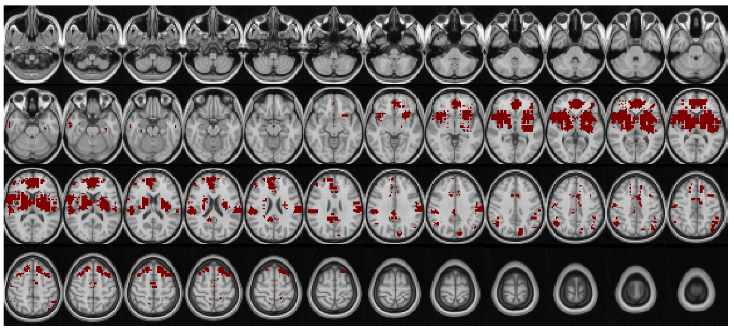
PT5
Patient Profile
Clinically determined R mesial frontal lobe onset
No abnormalities noted on pre-op MRI
At one year post-op, PT reported having auras not progressing to seizures
R L
SD Threshold = 5
Notes:
Top left image = sagittal post-op image showing resection zone
Top right image = axial post-op image showing resection zone
Bottom image = searchlight generated overlay of lesion regions

Slide 8
PT5 searchlight overlay with CT

Slide 9
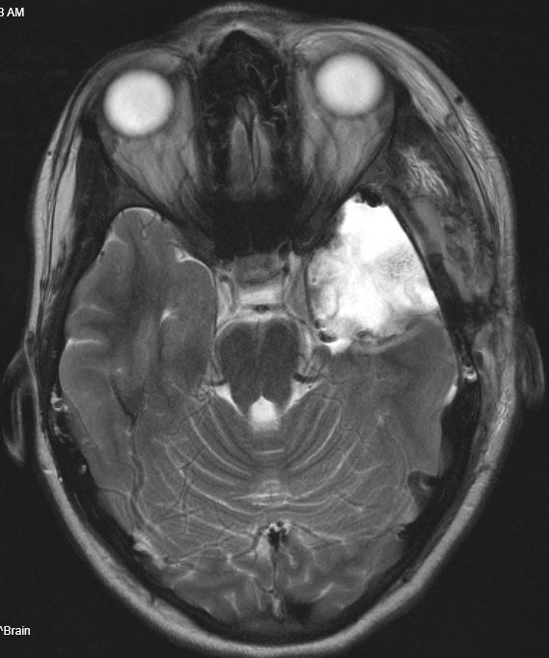
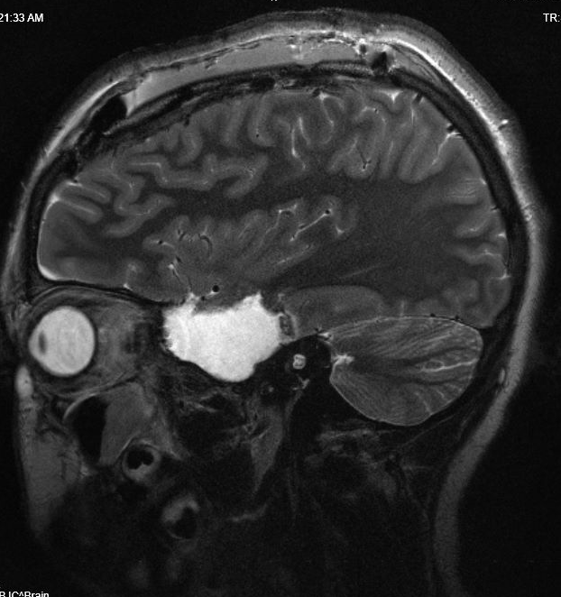
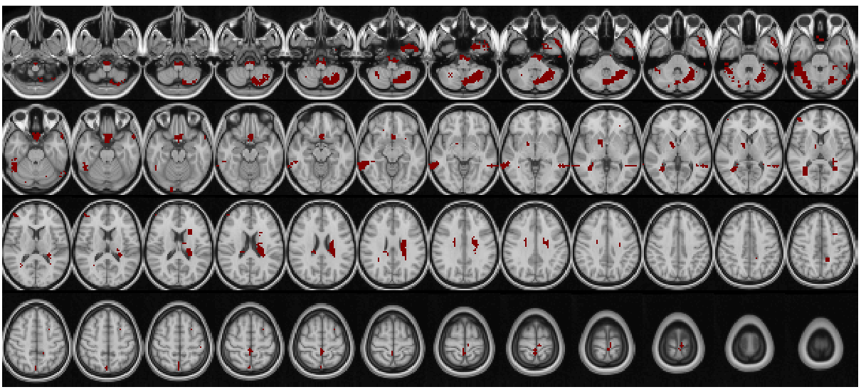
PT3
Patient Profile
Clinically determined L mesial anterior temporal lobe onset
No abnormalities noted on pre-op MRI
PT reported several seizures in at 1 year post-op visit
R L
SD Threshold = 2
Notes:
Top left image = sagittal post-op image showing resection zone
Top right image = axial post-op image showing resection zone
Bottom image = searchlight generated overlay of lesion regions

Slide 10
PT3 searchlight overlay with CT

Slide 11
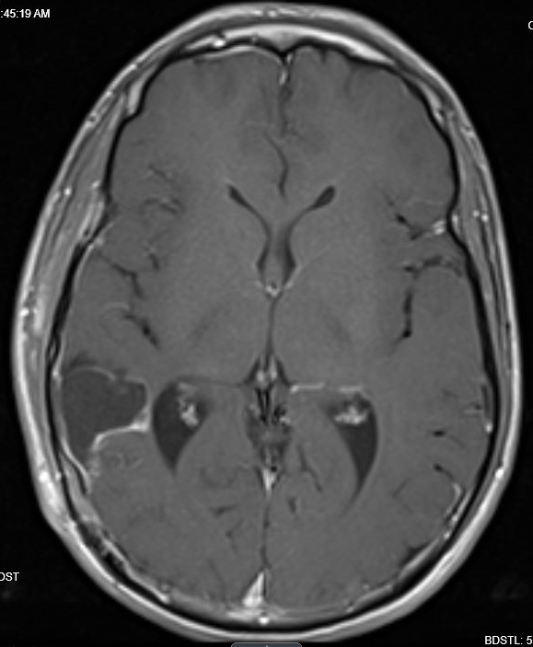
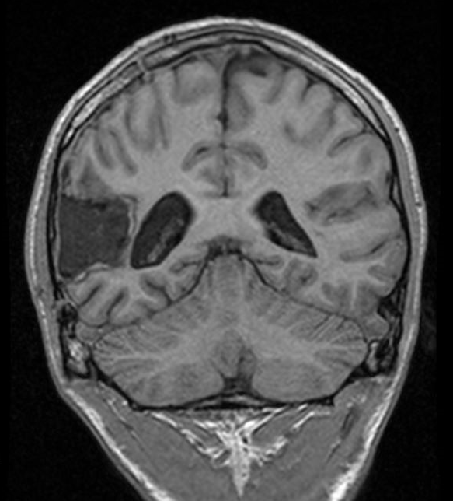
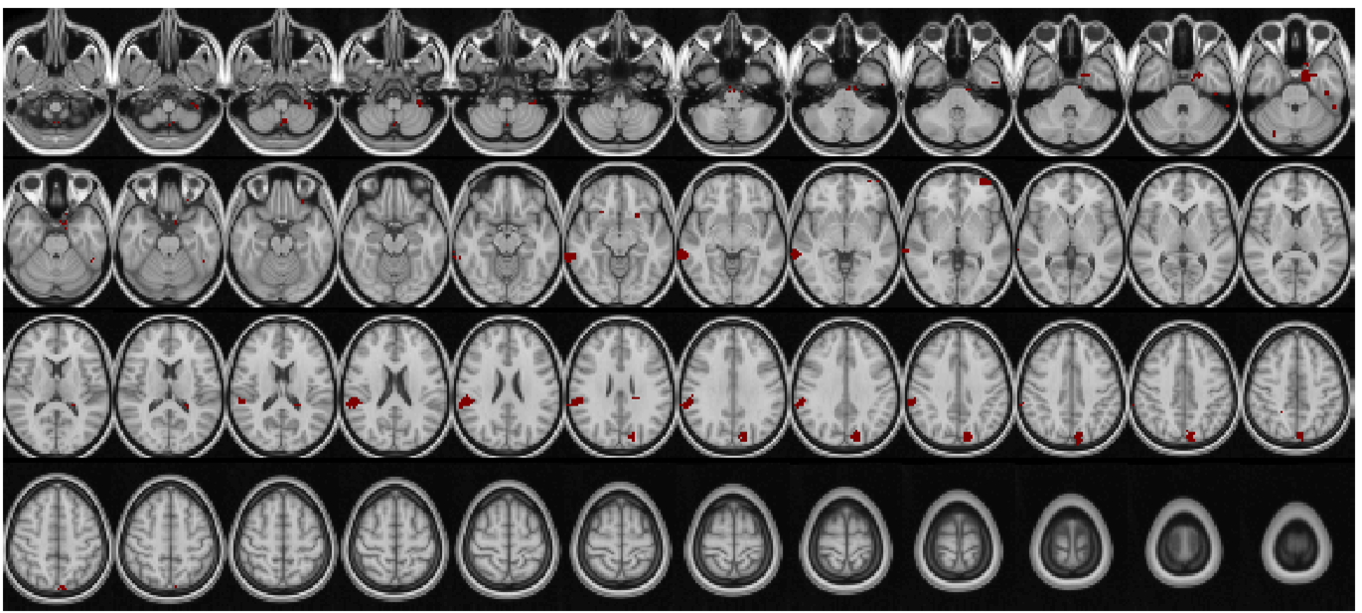
PT34
Patient Profile
Clinically demonstrated R cortical temporoparietal junction onset
Pre-op MRI showed mildly dilated posterior horn of the lateral ventricles and thinning of the adjacent white matter in parietal lobe.
No post-op notes regarding seizure status
R L
SD Threshold = 3
Notes:
Top left image = coronal post-op image showing resection zone
Top right image = axial post-op image showing resection zone
Bottom image = searchlight generated overlay of lesion regions

Slide 12
PT34 searchlight overlay with CT

Slide 13
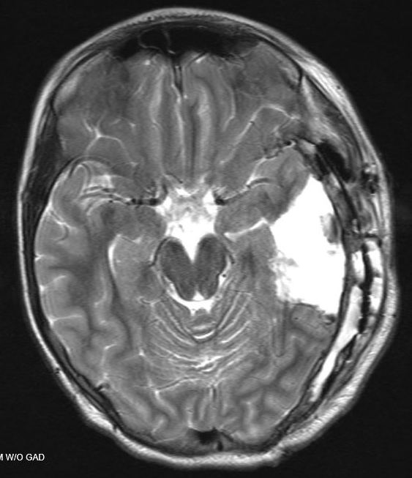
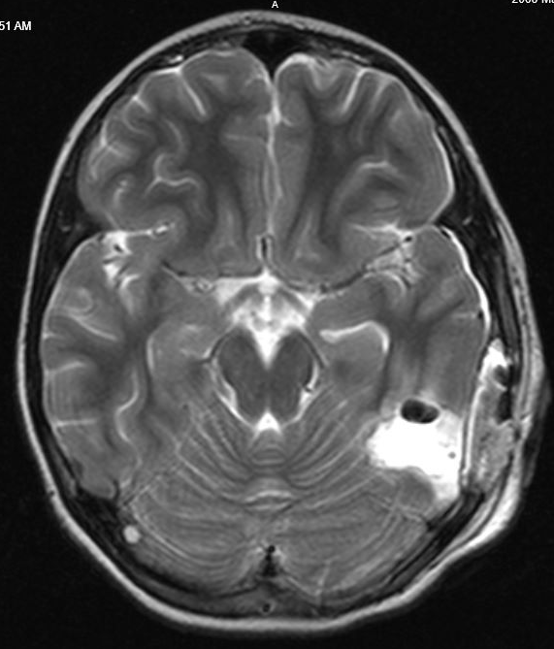
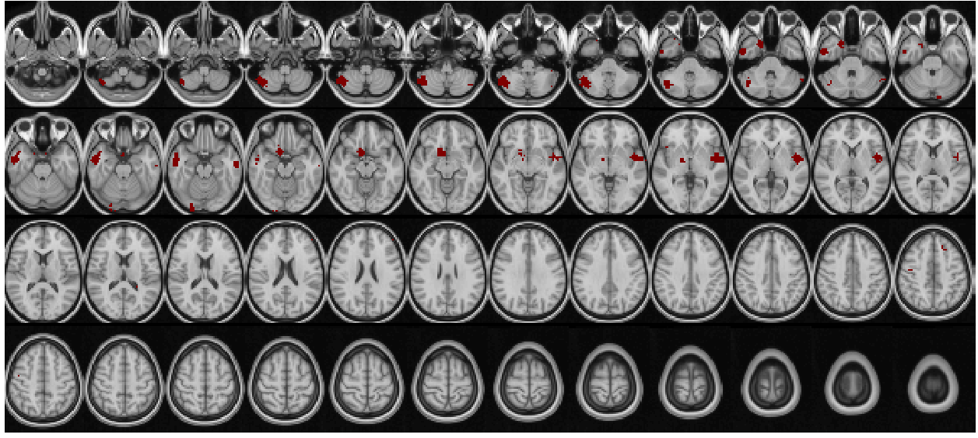
PT15
Post-epilepsy resection
Patient Profile
Clinically determined L basal temporal lobe seizure onset
History of L basal temporal ganglioglioma – resected 9 mo. prior to seizure focus resection
Seizure free at 1 year post-epilepsy resection
Image of ganglioglioma
R L
SD Threshold = 3
Notes:
Top left image = image of the L temporal lobe ganglioglioma that was resected 9 months prior to epilepsy surgery
Top right image = Post-epilepsy resection image
Bottom = searchlight lesion regions at an SD threshold of 3

Slide 14
PT15 searchlight overlay with CT

Slide 15
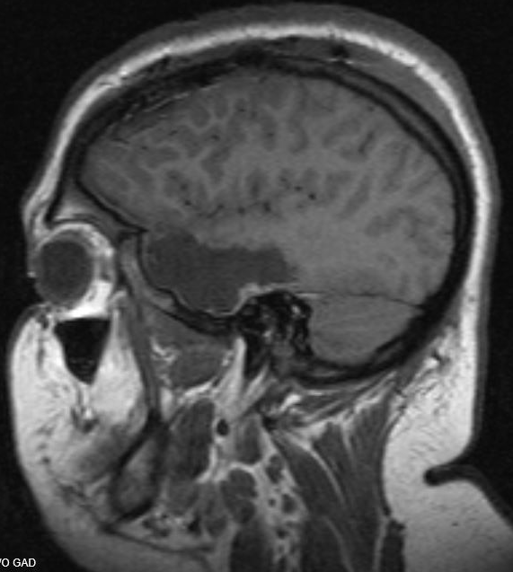
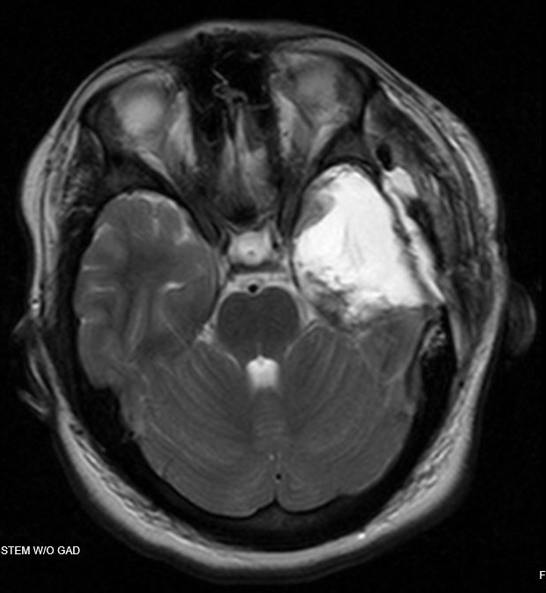
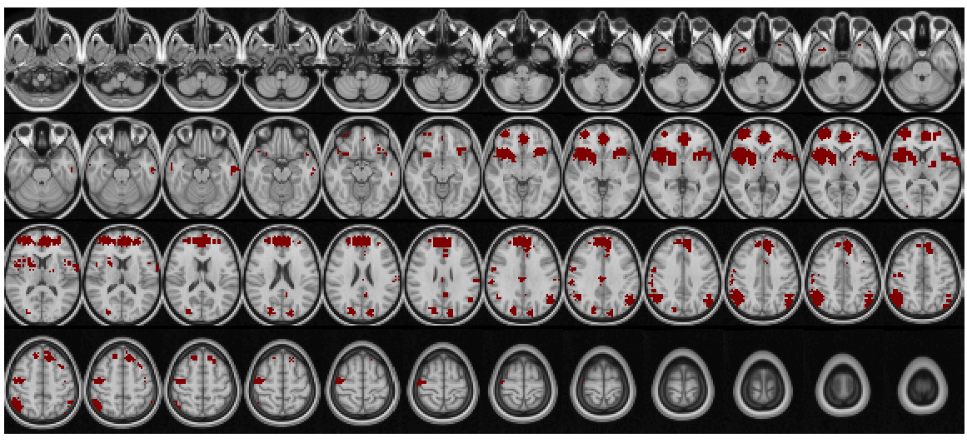
PT16
Patient Profile
Clinically determined L temporal lobe onset
History of psychiatric comorbidities
No abnormalities reported on pre-op MRI. Metabolic abnormalities bilaterally in the temporal lobes
Seizure free at 1 year post-epilepsy resection.
R L
SD Threshold = 5
Notes:
Top left image = sagittal post-op T1 image
Top right image = axial post-op T2 image
Bottom image = searchlight results at an SD threshold of 5

Slide 16
PT16 searchlight overlay with CT

Slide 17
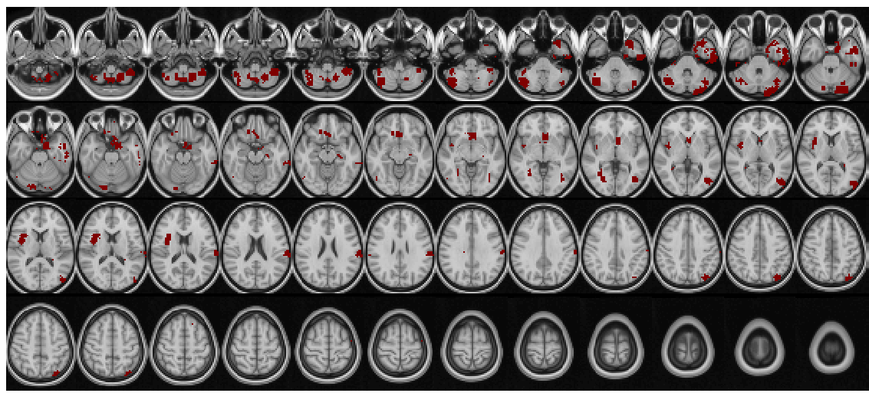
PT18
Patient Profile
Clinically determined L centroparieal onset near primary motor cortex
Received subpial transections near primary motor cortex.
Post-op treatment for MRE was unsuccessful. PT continued having seizures within 1 year post-op.
Post-subpial transection MRI not on ClinDesk.
Notes:
Bottom image = searchlight generated overlay of lesion regions

Slide 18
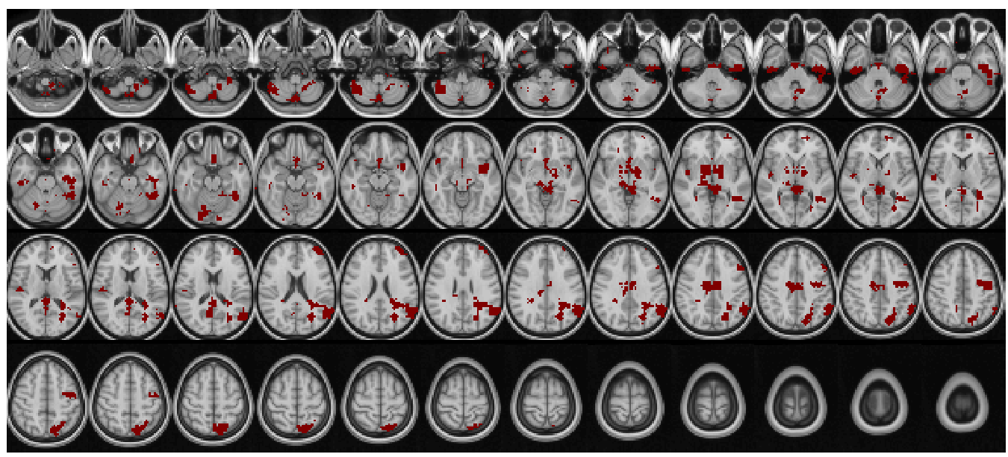
PT20
Patient Profile
Clinically determined L mediotemporal onset
Pre-op MRI showed an area of hyper intensity adjacent to the right lateral ventricle. Suggestive of small vessel ischemic disease.
Resection treatment for MRE was unsuccessful. PT continued having seizures within 1 year post-op.
Post-op MRI not on ClinDesk
Reports of receiving L temporal lobectomy.
Notes:
Bottom image = searchlight generated overlay of lesion regions

Slide 19
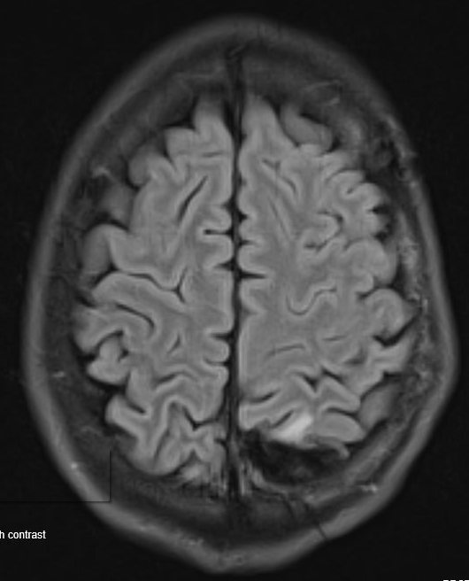
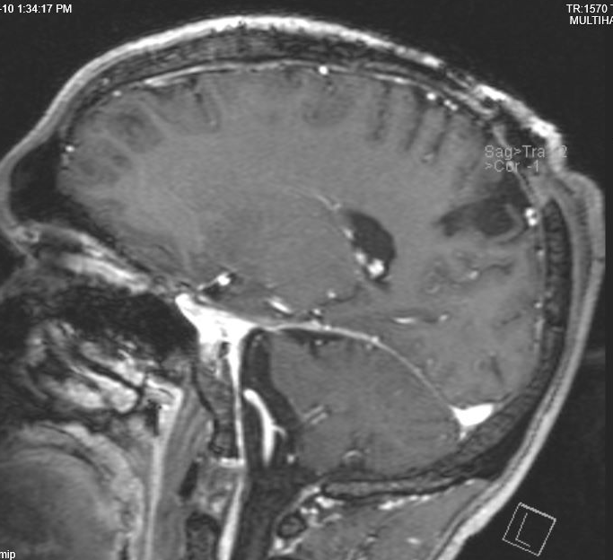
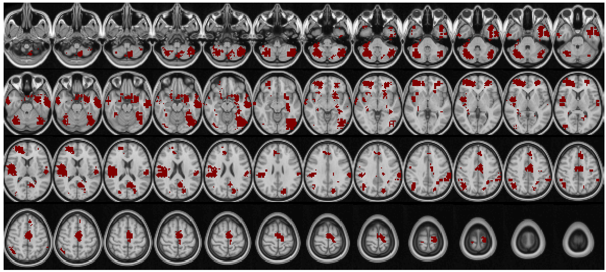
PT26
Patient Profile
Clinically determined L mesial parietal onset
No abnormalities noted on pre-op MRI
Post-op treatment for MRE was unsuccessful. PT continued having seizures within 1 year post-op.
R L
SD Threshold = 3
Notes:
Top left image = sagittal post-op image showing occipital resection zone
Top right image = axial post-op image showing resection zone
Bottom image = searchlight generated overlay of lesion regions

Slide 20
PT26 searchlight overlay with CT

Slide 21
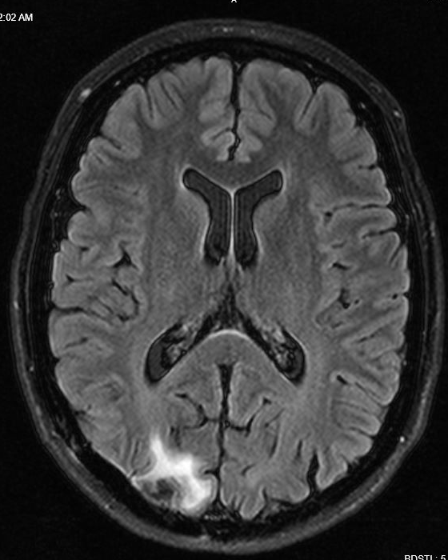
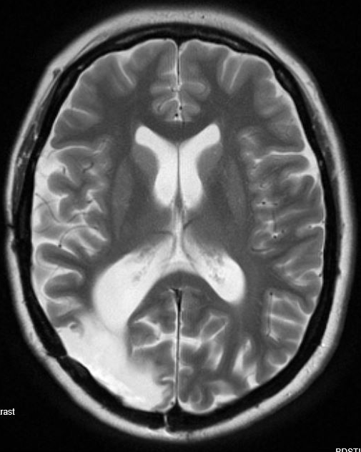
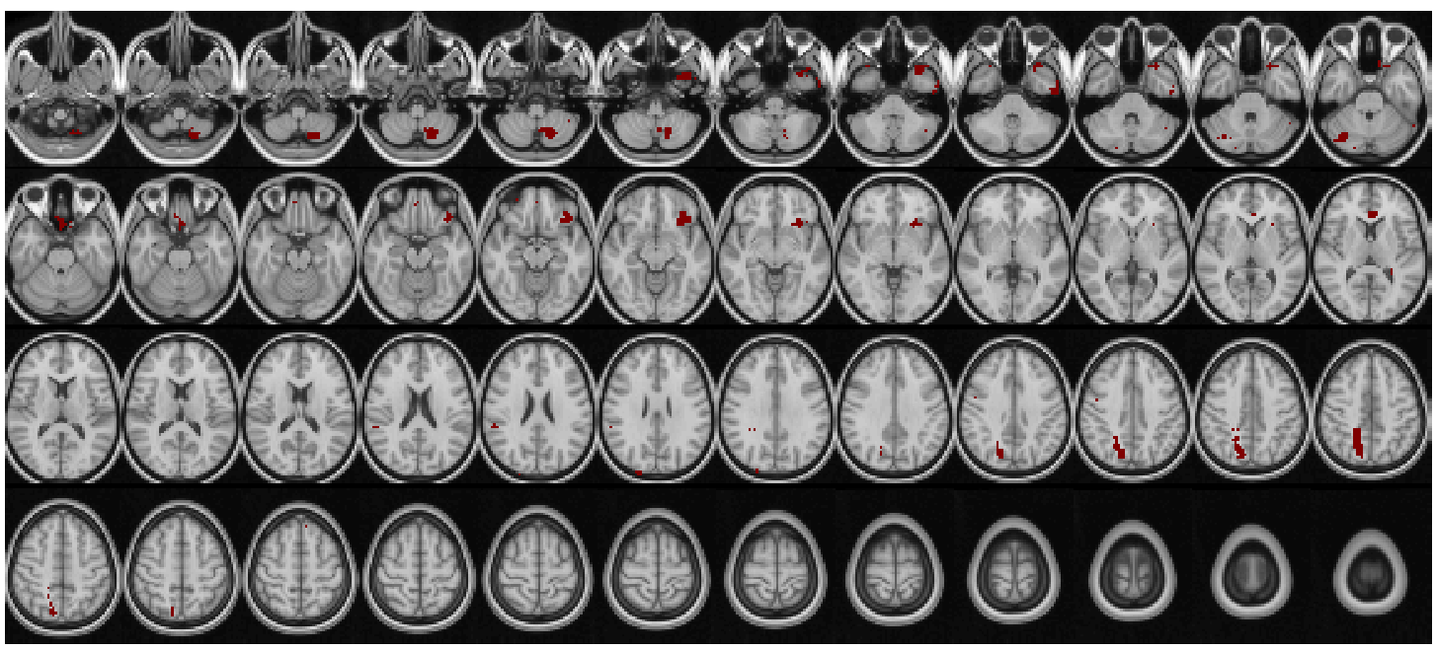
PT28
Patient Profile
Clinically determined R parieto-occipital onset
Pre-op MRI indicated prior resection of right occipital meningioma
Got further resection of seizure onset zone.
Seizure free at 1 year post-epilepsy resection.
Meningioma resection
Post-epilepsy focus resection
SD Threshold = 3
Notes:
Top left image = axial image showing R sided meningioma resection. This resection occurred prior to epilepsy related resection.
Top right image = axial image showing post-epilepsy surgery resection zone

Slide 22
PT28 searchlight overlay with CT

Slide 23
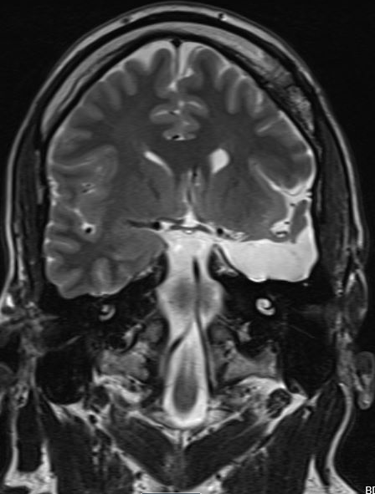
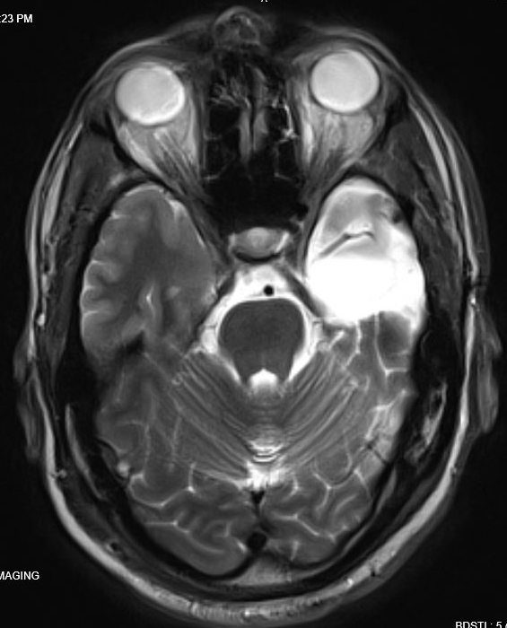
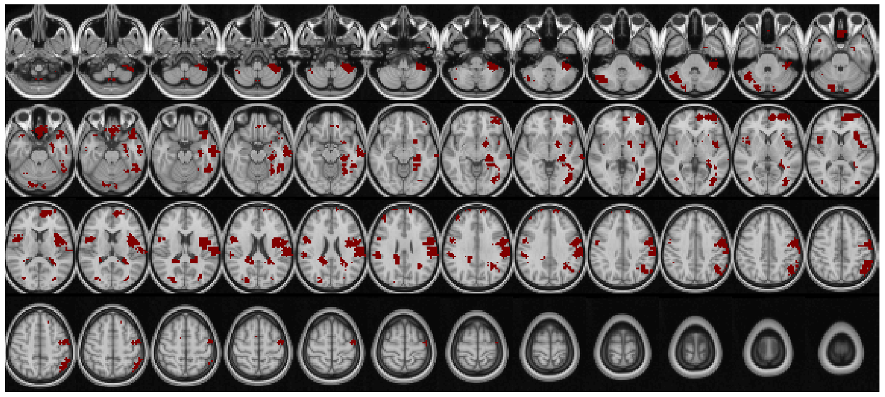
PT32
Patient Profile
Clinically determined L mesial temporal onset.
Pre-op MRI indicated mesial temporal sclerosis
Seizure free at 1 year post-epilepsy resection.
SD Threshold = 3
Notes:
Top left image = coronal post-op image showing resection zone – resection of L anterior temporal lobe
Top right image = axial post-op image showing resection zone
Bottom image = searchlight generated overlay of lesion regions

Slide 24
PT32 searchlight overlay with CT

Slide 25
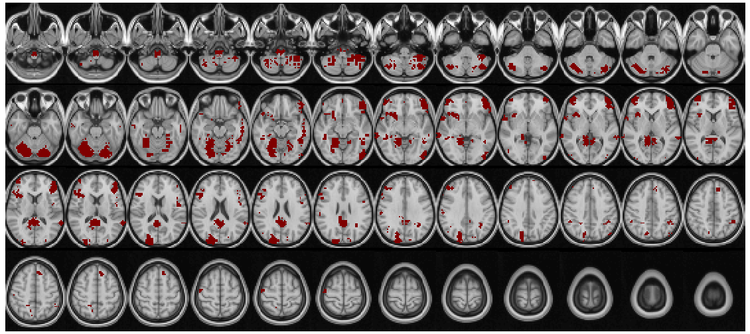
PT33
Patient Profile
Clinically determined L temporal lobe onset
Pre-op MRI indicated several scattered white mater T2/FLAIR hyperintensities
Resection treatment for MRE was unsuccessful. PT continued having seizures within 1 year post-op.
Post-op MRI not in ClinDesk record. Reports of L anterior temporal lobe resection with hippocampectomy.
SD Threshold = 4
Notes:
Bottom image = searchlight generated overlay of lesion regions

Slide 26
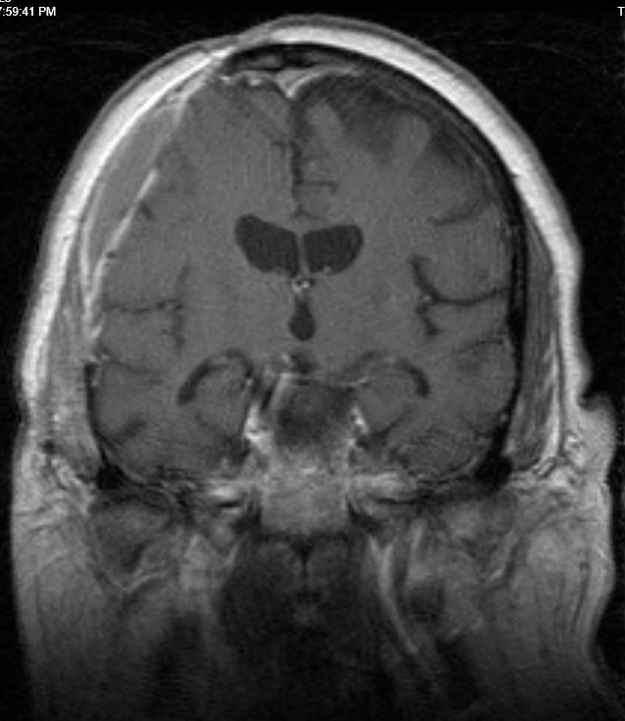
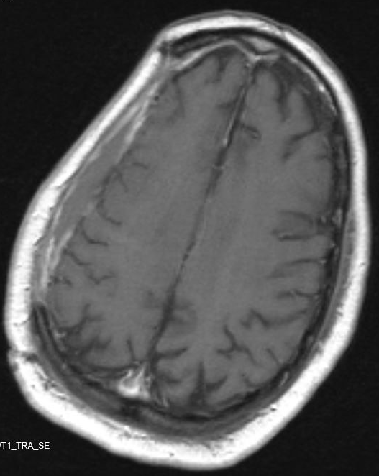
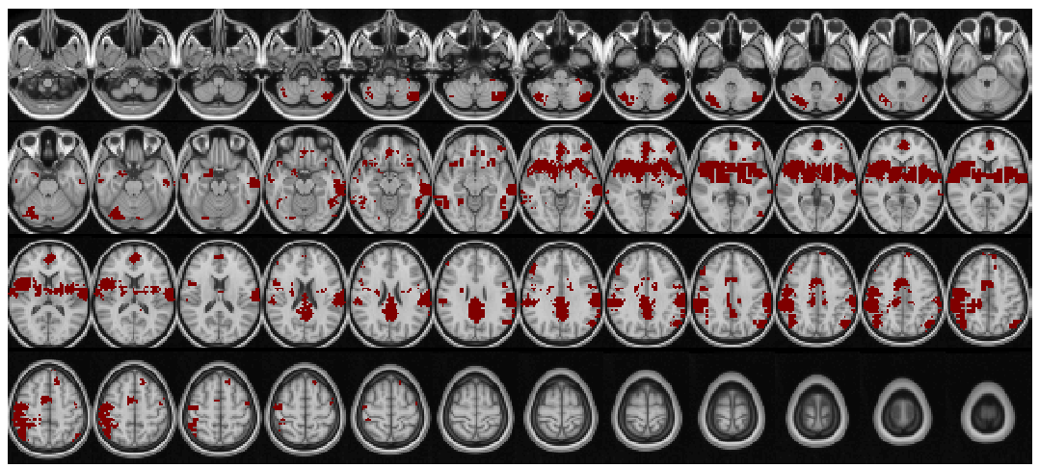
PT35
Patient Profile
Clinically determined to have R frontoparietal onset
Pre-op MRI indicated R medial posterior frontal lobe lesion of unknown significance
PT received subpial cortical transections
Transection treatment for MRE was unsuccessful. PT continued having seizures within 1 year post-op.
SD Threshold = 4
Notes:
Top left image = coronal post-op image showing resection zone
Top right image = axial post-op image showing resection zone
Bottom image = searchlight generated overlay of lesion regions

Slide 27
PT35 overlay with CT

